Slide 1

Introduction
Overview
Intrusion Detection System (IDS) is a network traffic monitoring system that detects suspicious behavior and sends out notifications when it is found.

Slide 2
Types of IDS
1.Based on Data Source
Host Based IDS
Network Based IDS

Slide 3


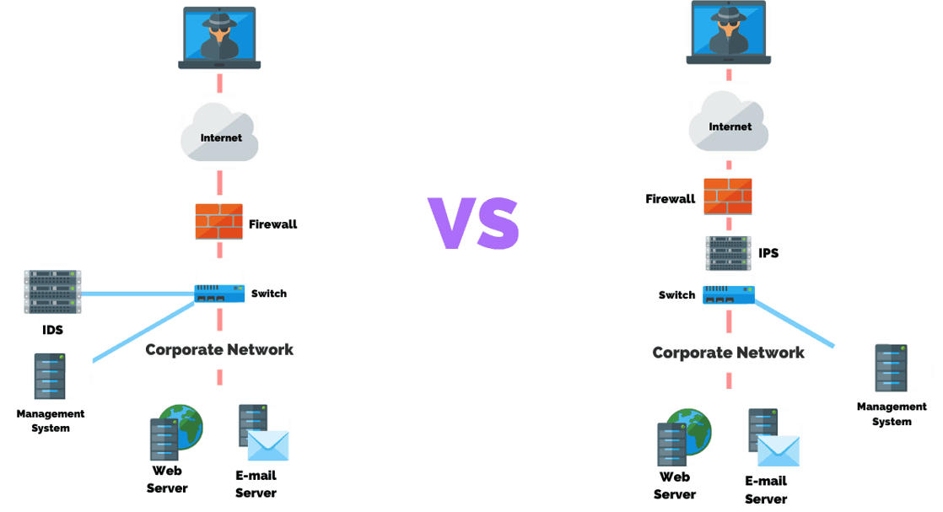
IDS VS IPS

Slide 4
Problem Statement with Objective
Traditional intrusion detection models in the Industrial Internet of Things (IIoT) suffer from low detection rates, classification inaccuracies, and high false detection rates, posing significant security risks. To address these challenges, this paper proposes NIDS-CNNLSTM, a novel deep learning-based model.
By integrating convolutional neural networks (CNNs) and long short-term memory (LSTM) networks.

Slide 5
Requirement Engineering
Tools used
Programming language : Python 3.6
Libraries: Numpy, Tensorflow, Sklearn, Pandas, Seaborn, jonlib, keras, Matplotlib etc
Software: Jupyter, Spyder
User Requirements
Simple and dynamic interface
Accurate Analysis
Less response time

Slide 6
Software Requirements
Operating System: Windows
Predetermined dataset
Usage of multiprocessing
Hardware Requirements
Processor (CPU) with 2 gigahertz (GHz) frequency or above
Minimum of 4 GB of RAM and minimum of 2 GB of available space on the hard disk.
Internet Connection Broadband connection with a speed of 2 Mbps or higher.

Slide 7
Software Requirements Specification
Functional Requirements
Data Pre-processing: Cleaning, transforming and reducing data to convert raw data in a useful manner.
Training: Learning how to perform the required task based on the inputs given through the dataset.
Forecasting: Making predictions of the future based on past and present data by analysis of trends.

Slide 8
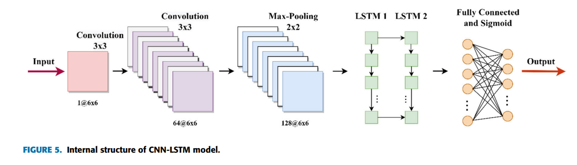
Methodology

Slide 9
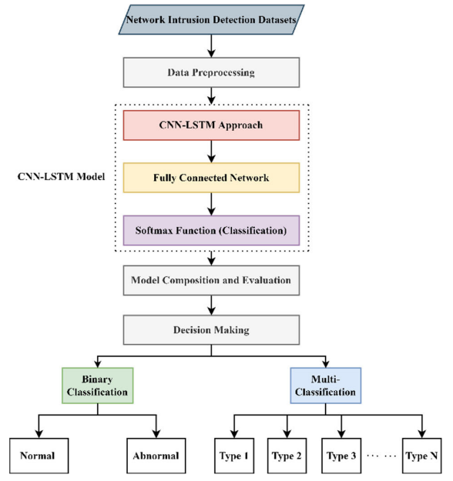
Contd…

Slide 10
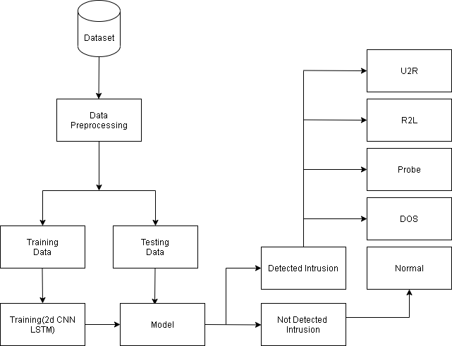
System Design

Slide 11
Algorithm
Inputs
Datasets (NSL-KDD dataset)
Parameters (e.g., duration, protocol_type, service, flag, src_bytes, logged_in etc.)
Outputs
Trained CNN-LSTM model
Load the dataset and extract features and produce which type of attack has occurred (DoS, Normal, Probe, R2L, U2R).

Slide 12
Algorithm
Split the dataset into training, validation, and test sets.
Define the CNN-LSTM model architecture:
The input features are then passed through a 1D convolutional layer with a specified number of filters and kernel size.
The output of the convolutional layer is then passed through a max pooling layer to reduce the dimensionality of the data.
The output of the max pooling layer is then passed through a LSTM layer with a specified number of units.

Slide 13
Algorithm
The output of the LSTM layer is then passed through a dense layer with a specified number of units and the ReLU activation function.
Finally, the output of the dense layer is passed through a softmax layer to get the predicted class probabilities.

Slide 14
Algorithm
Compile the model with appropriate loss function and optimizer.
Train the model on the training data using batches of features:
Feed the features to the CNN layers to extract the temporal features.
Feed the temporal features to the LSTM layer to model the temporal dependencies.
Compute the output probabilities.

Slide 15
Algorithm
Compute the loss between the predicted and true labels.
Use backpropagation to update the model parameters to minimize the loss.
Evaluate the model performance on the validation set:
Compute the prediction accuracy.
Fine-tune the model hyperparameters (e.g., learning rate, number of epochs, batch size, etc.) based on the validation set performance.

Slide 16
Algorithm
Test the final model on the test set:
Compute the prediction accuracy and other evaluation metrics.
Analyze the confusion matrix to see how the model performs
Save the trained model for future use.

Slide 17
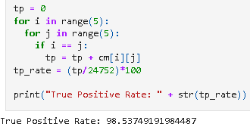

Results and Performance Analysis

Slide 18
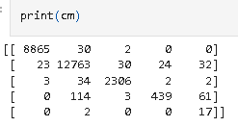
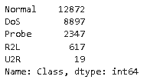

Slide 19
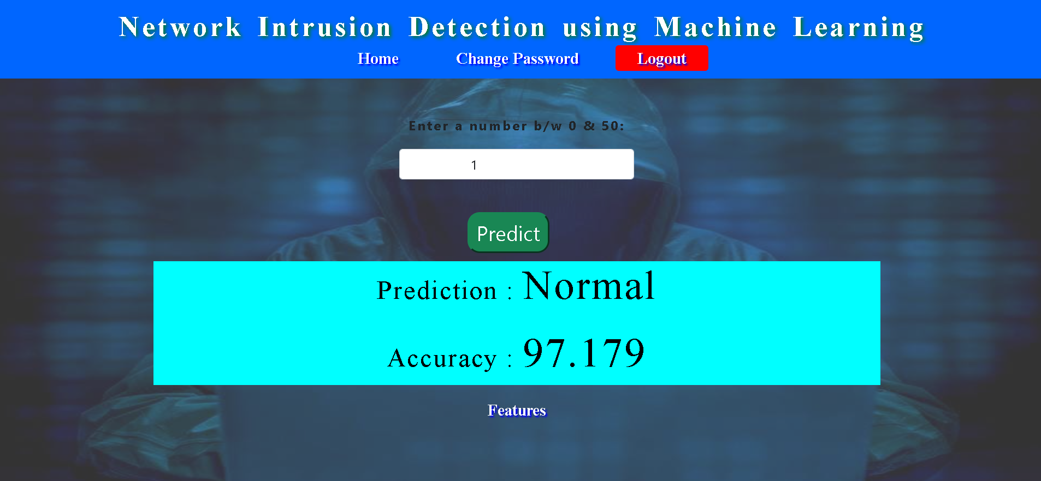
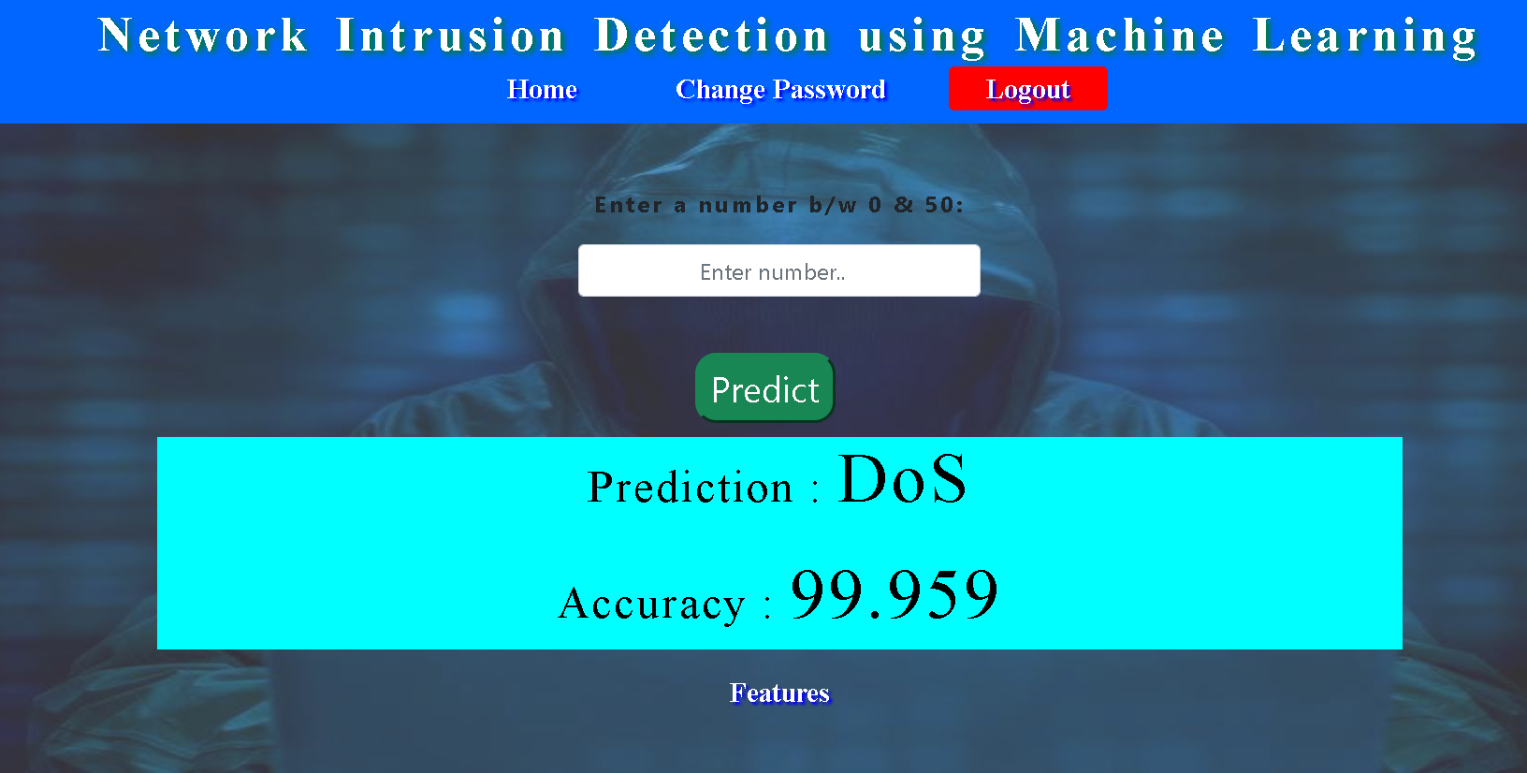
Snapshots
19/20

Slide 20
Applications
• Monitoring the operation of routers, firewalls, key management servers and files that are needed by other security controls aimed at detecting, preventing or recovering from cyber attacks.
• Providing administrators a way to tune, organize and understand relevant OS audit trails and other logs that are otherwise difficult to track or parse.
• Providing a user-friendly interface so non expert staff members can assist with managing system security.
• Generating an alarm and notifying that security has been breached; and reacting to intruders by blocking them or blocking the serve

Slide 21
Conclusion
In this project we have proposed a system which presents CNN LSTM networks to recognize Intrusion Detection
The performances of the two networks would be tested
An integrated feature space will produce a better recognition rate when compared to a single feature.

Slide 22
Future Research Challenges
The existing system uses ML models and DL models.
The efficiency of the AI-powered NIDS highly depends upon training using a suitable dataset. For ML models, the algorithm can be trained using a small dataset to achieve better results.
We observed that in most of the proposed solutions, models are tested using older dataset such as KDD Cup'99.
We also observed that in some proposed solutions, the performance of the model showing extremely excellent results for older datasets is decreased for newer and recently proposed datasets

Slide 23
References
[1] Chongrui Tian,, Fengbin Zhang , Zhaoxiang Li,Ruidong Wang,Xunhua Huang,Liang Xi, and Yi Zhang “Intrusion Detection Method Based on Deep Learning” , Hindawi ,15 July 2022.
[2] Muhammad Naveed , Fahim Arif , Syed Muhammad Usman , Aamir Anwar , Myriam Hadjouni , Hela Elmannai,Saddam Hussain , Syed Sajid Ullah ,and Fazlullah Umar” A Deep Learning-Based Framework for Feature Extraction and Classification of Intrusion Detection in Networks” , Hindawi, 8 August 2022.
[3] Emrah Tufan1,Cihangir Tezcan,And Cengiz Acartürk. “Anomaly-Based Intrusion Detection by Machine Learning: A Case Study on Probing Attacks to an Institutional Network” IEEE, April 6, 2021.
[4] Sara Al-Emadi, Aisha Al-Mohannadi, Felwa Al-Senaid. “Using Deep Learning Techniques for Network Intrusion Detection”IEEE, May 18,2020.
[5] Akhil Krishna, Ashik Lal M A, Athul Joe Mathewkutty, Dhanya Sarah Jacob, Hari M “Intrusion Detection and Prevention System Using Deep Learning” International Conference on Electronics and Sustainable Communication Systems , 2020.

